Slide 1
Database Design – Schema Refinement - Guidelines for Relational Schema
MODULE 3
T. JOSHVA DEVADAS
PROFESSOR
SJT ANNEX 103F

Slide 2
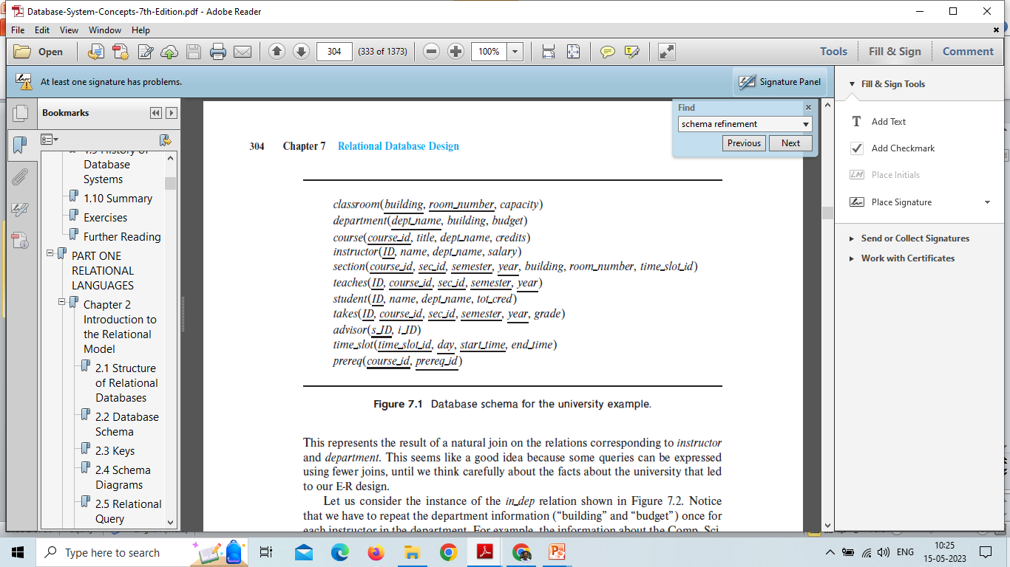
Features of Good Relational Designs
Let us consider the university Database schema

Slide 3
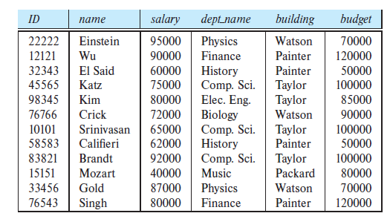
Suppose that we had started out when designing the university enterprise with the schema in dep.
in dep (ID, name, salary, dept name, building, budget)
This represents the result of a natural join on the relations corresponding to instructor and department.

Slide 4
Notice that we have to repeat the department information (“building” and “budget”) once for each instructor in the department.
For example, the information about the Comp. Sci. department (Taylor, 100000) is included in the tuples of instructors Katz, Srinivasan, and Brandt.
It is important that all these tuples agree as to the budget amount since otherwise our database would be inconsistent.
In our original design using instructor and department, we stored the amount of each budget exactly once.
This suggests that using in dep is a bad idea since it stores the budget amounts redundantly and runs the risk that some user might update the budget amount in one tuple but not all, and thus create inconsistency.

Slide 5
Moreover inserting a new department may cause issues because it need at least one instructor at the university.
tuples in the in dep table require values for ID, name, and salary.
This means that we cannot record information about the newly created department until the first instructor is hired for the new department
In the old design, the schema department can handle this, but under the revised design, we would have to create a tuple with a null value for building and budget.
To overcome this issue we are going for schema refinement

Slide 6
Schema Refinement
The Schema Refinement refers to refine the schema by using some technique.
The best technique of schema refinement is decomposition.
In general, a schema that exhibits repetition of information may have to be decomposed into several smaller schemas
Normalization or Schema Refinement is a technique of organizing the data in the database.
It is a systematic approach of decomposing tables to eliminate data redundancy and undesirable characteristics like Insertion, Update and Deletion Anomalies.
Redundancy refers to repetition of same data or duplicate copies of same data stored in different locations.
Anomalies: Anomalies refers to the problems occurred after poorly planned and normalized databases where all the data is stored in one table which is sometimes called a flat file database.

Slide 7
Not all decompositions of schemas are helpful. Consider an extreme case in which all schemas consist of one attribute.
No interesting relationships of any kind could be expressed.
Now consider a less extreme case where we choose to decompose the employee schema.
employee (ID, name, street, city, salary)
into the following two schemas:
employee1 (ID, name)
employee2 (name, street, city, salary)

Slide 8
The flaw in this decomposition arises from the possibility that the enterprise has two employees with the same name.
Each person would have a unique employee-id, which is why ID can serve as the primary key. As an example, let us assume two employees, both named Kim, work at the university and have the following tuples in the relation
on schema employee in the original design:
(57766, Kim, Main, Perryridge, 75000)
(98776, Kim, North, Hampton, 67000)
the resulting tuples using the schemas resulting from the decomposition, and the result if we attempted to regenerate the original tuples using a natural join.
As we see , the two original tuples appear in the result along with two new tuples that incorrectly mix data values pertaining to the two employees named Kim.
Although we have more tuples, we actually have less information in the following sense.

Slide 9
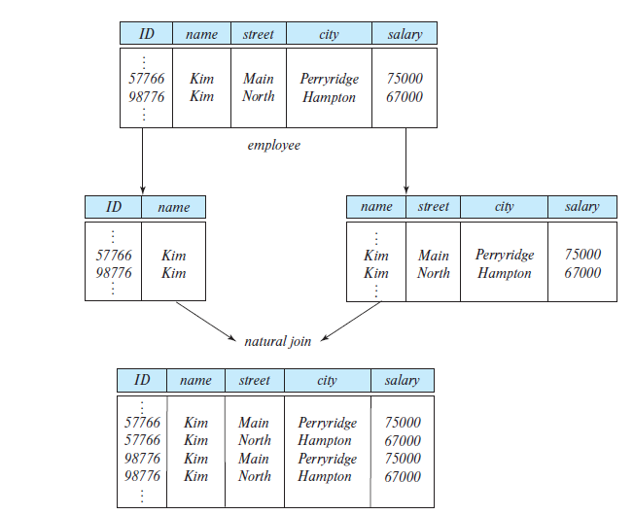
Loss of information via a bad decomposition
We shall refer to such decompositions as being lossy decompositions, and, conversely, to those that are not as lossless decompositions.

Slide 10
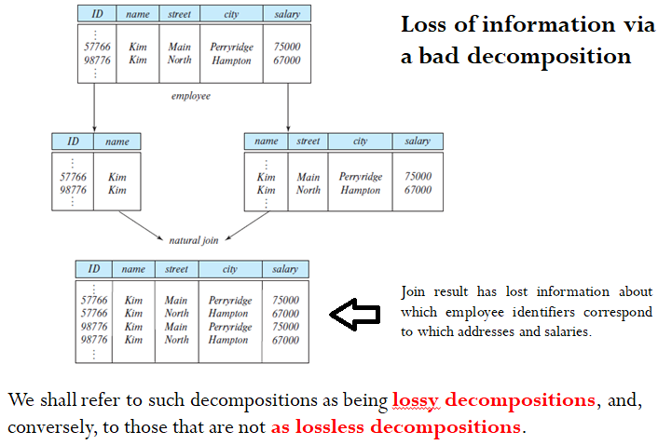

Slide 11
Lossless Decomposition
Let R be a relation schema and let R1 and R2 form a decomposition of R—that is, viewing R, R1, and R2 as sets of attributes, R = R1 ∪ R2.
We say that the decomposition is a lossless decomposition if there is no loss of information by replacing R with two relation schemas R1 and R2.
More precisely, we say the decomposition is lossless if, for all legal database instances, relation r contains the same set of tuples as the result of the following SQL query:
select * from (select R₁ from r) natural join (select R₂ from r)
In other words, if we project r onto R₁ and R₂, and compute the natural join of the projection results, we get back exactly r.
ΠR₁ (r) ⋈ ΠR₂(r) = r

Slide 12
Conversely, a decomposition is lossy if when we compute the natural join of the projection results, we get a proper superset of the original relation.
This is stated more briefly in the relational algebra as:
r ⊂ ΠR₁ (r) ⋈ ΠR₂ (r)

Slide 13
Design guidelines for Relational Schema
informal guidelines that may be used as measures to determine the quality of relation schema design:
Making sure that the semantics of the attributes is clear in the schema
Reducing the redundant information in tuples
Reducing the NULL values in tuples
Disallowing the possibility of generating spurious tuples
These measures are not always independent of one another, as

Slide 14
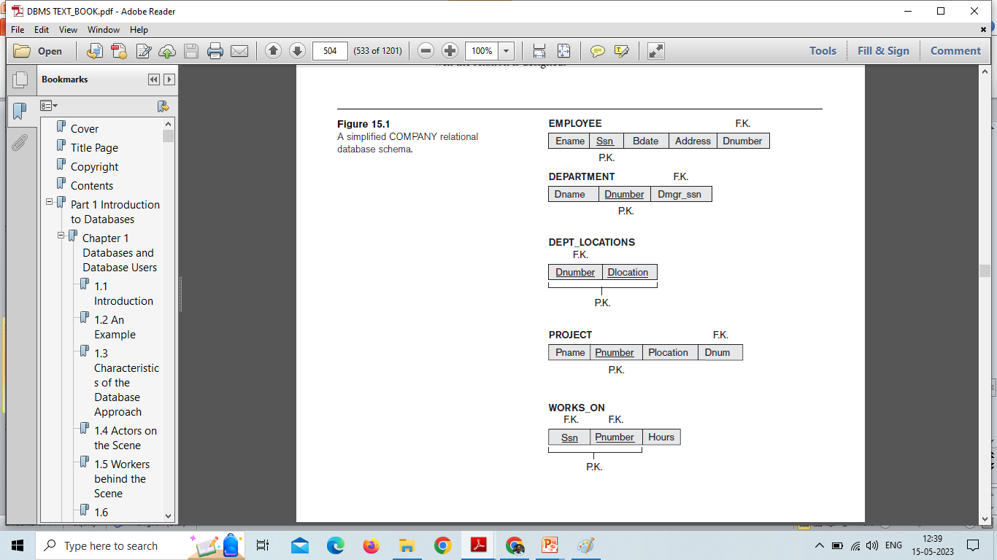
1. Imparting Clear Semantics to Attributes in Relations

Slide 15
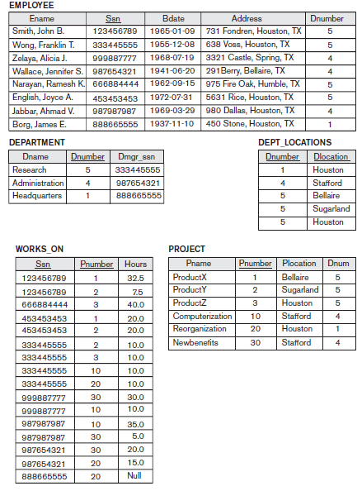

Slide 16
Guideline 1
Design a relation schema so that it is easy to explain its meaning.
Do not combine attributes from multiple entity types and relationship types into a single relation.
Intuitively, if a relation schema corresponds to one entity type or one relationship type, it is straightforward to interpret and to explain its meaning.
Otherwise, if the relation corresponds to a mixture of multiple entities and relationships, semantic ambiguities will result and the relation cannot be easily explained.

Slide 17
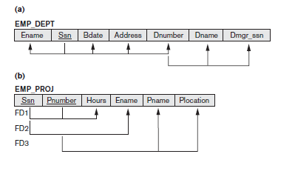
Violation of Guideline 1

Slide 18
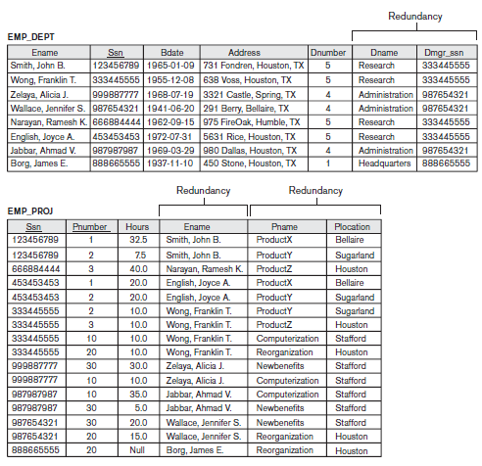
2. Redundant Information in Tuples and Update Anomalies

Slide 19
Anomalies
Insert Anomaly
To insert a new employee tuple into EMP_DEPT
It is difficult to insert a new department that has no employees as yet in the EMP_DEPT relation.
Deletion Anomaly
If we delete from EMP_DEPT an employee tuple that happens to represent the last employee working for a particular department, the information concerning that department is lost from the database
Modification Anomaly
if we change the value of one of the attributes of a particular department we must update the tuples of all employees who work in that department; otherwise, the database will become inconsistent.

Slide 20
Guideline 2
Design the base relation schemas so that no insertion, deletion, or modification anomalies are present in the relations.
If any anomalies are present, note them clearly and make sure that the programs that update the database will operate correctly.

Slide 21
3. NULL Values in Tuples
In some schema designs we may group many attributes together into a “fat” relation.
If many of the attributes do not apply to all tuples in the relation, we end up with many NULLs in those tuples.
This can waste space at the storage level and may also lead to problems with understanding the meaning of the attributes and with specifying JOIN operations at the logical level.
Another problem with NULLs is how to account for them when aggregate operations such as COUNT or SUM are applied.
SELECT and JOIN operations involve comparisons; if NULL values are present, the results may become unpredictable.

Slide 22
NULLs can have multiple interpretations, such as the following:
■ The attribute does not apply to this tuple. For ex : Visa_status may not apply to U.S. students.
■ The attribute value for this tuple is unknown. For ex: the Date_of_birth may be unknown for an employee.
■ The value is known but absent; that is, it has not been recorded yet. For ex : the Home_Phone_Number for an employee may exist, but may not be available and recorded yet.

Slide 23
Guideline 3
As far as possible, avoid placing attributes in a base relation whose values may frequently be NULL.
If NULLs are unavoidable, make sure that they apply in exceptional cases only and do not apply to a majority of tuples in the relation.

Slide 24
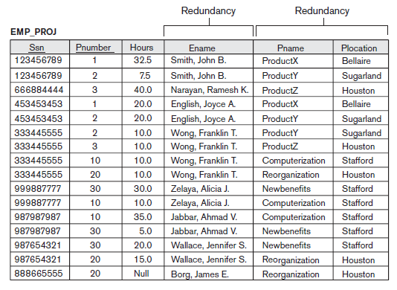
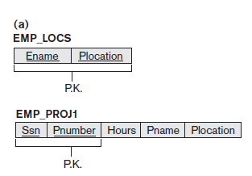
4.Generation of Spurious Tuples

Slide 25
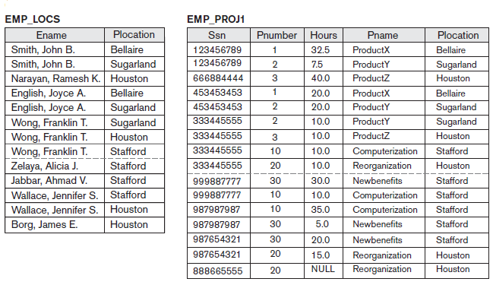

Slide 26
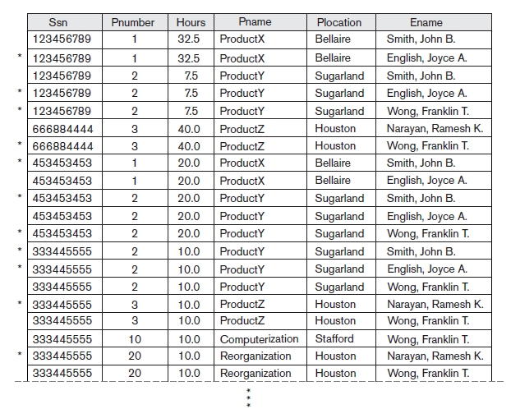
Result of applying NATURAL JOIN to the tuples in EMP_PROJ1 and EMP_LOCS Generated spurious tuples are marked by asterisks. They represent spurious information that is not valid.

Slide 27
Decomposing EMP_PROJ into EMP_LOCS and EMP_PROJ1 is undesirable because when we JOIN them back using NATURAL JOIN, we are not getting the correct original information.
This is because in this case Plocation is the attribute that relates EMP_LOCS and EMP_PROJ1, and Plocation is neither a primary key nor a foreign key in either EMP_LOCS or EMP_PROJ1.

Slide 28
Guideline 4
Design relation schemas so that they can be joined with equality conditions on attributes that are appropriately related (primary key, foreign key) pairs in a way that guarantees that no spurious tuples are generated.
Avoid relations that contain matching attributes that are not (foreign key, primary key) combinations because joining on such attributes may produce spurious tuples.

Slide 29
Summary and Discussion of Design Guidelines
Anomalies that cause redundant work to be done during insertion into and modification of a relation, and that may cause accidental loss of information during a deletion from a relation
Waste of storage space due to NULLs and the difficulty of performing selections, aggregation operations, and joins due to NULL values
Generation of invalid and spurious data during joins on base relations with matched attributes that may not represent a proper (foreign key, primary key) relationship.

Slide 30
Schema Refinement
Normalization
Data analysis technique to design a Database system
Abnormal data to normal data
Properties
No redundancy
No update anomaly

Slide 31
Schema Refinement
Normalization
Functional Dependencies
Finding the key attribute

